Slide 1
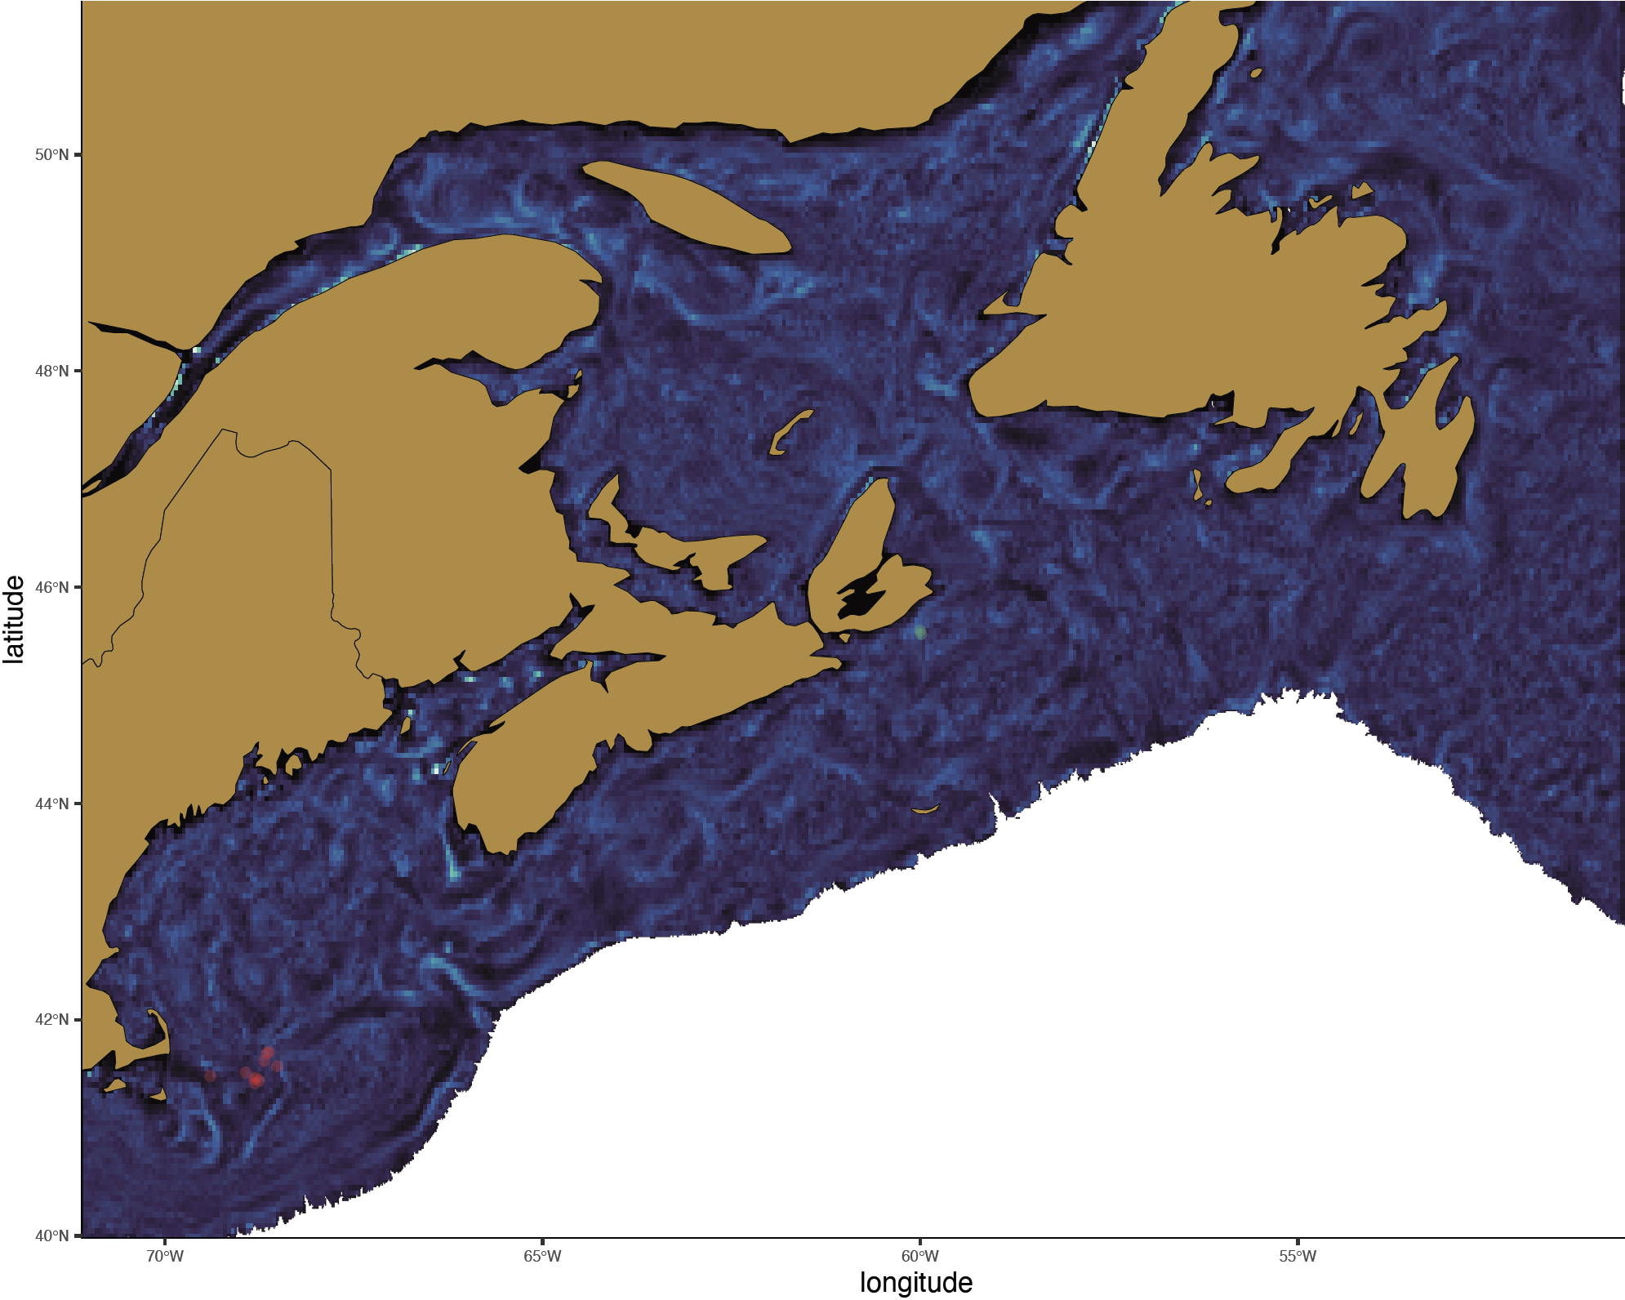
2018
May - 08
Late C. hyperboreus

Slide 2
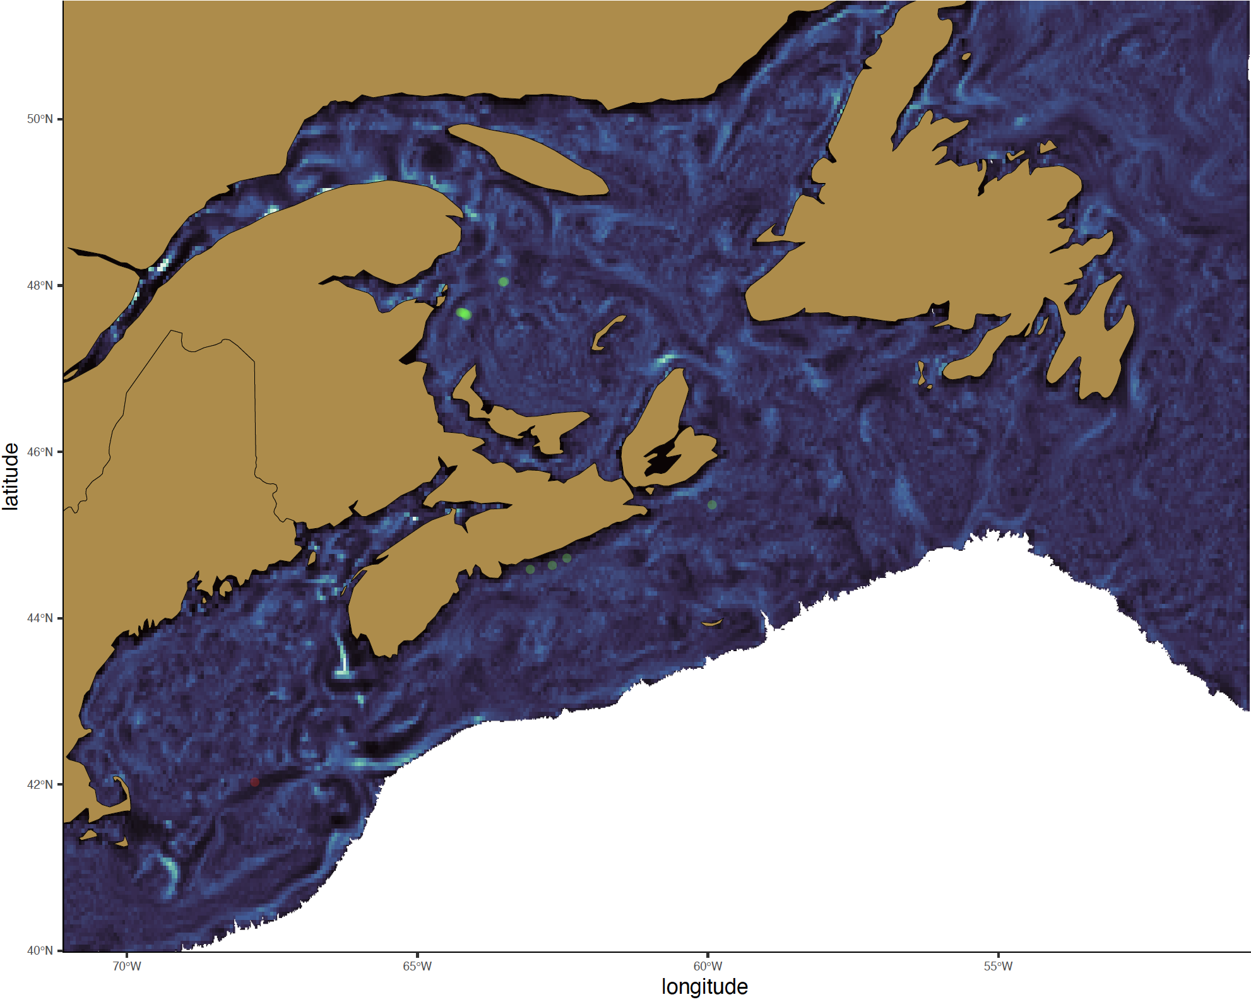
2018
May - 16
Late C. hyperboreus

Slide 3
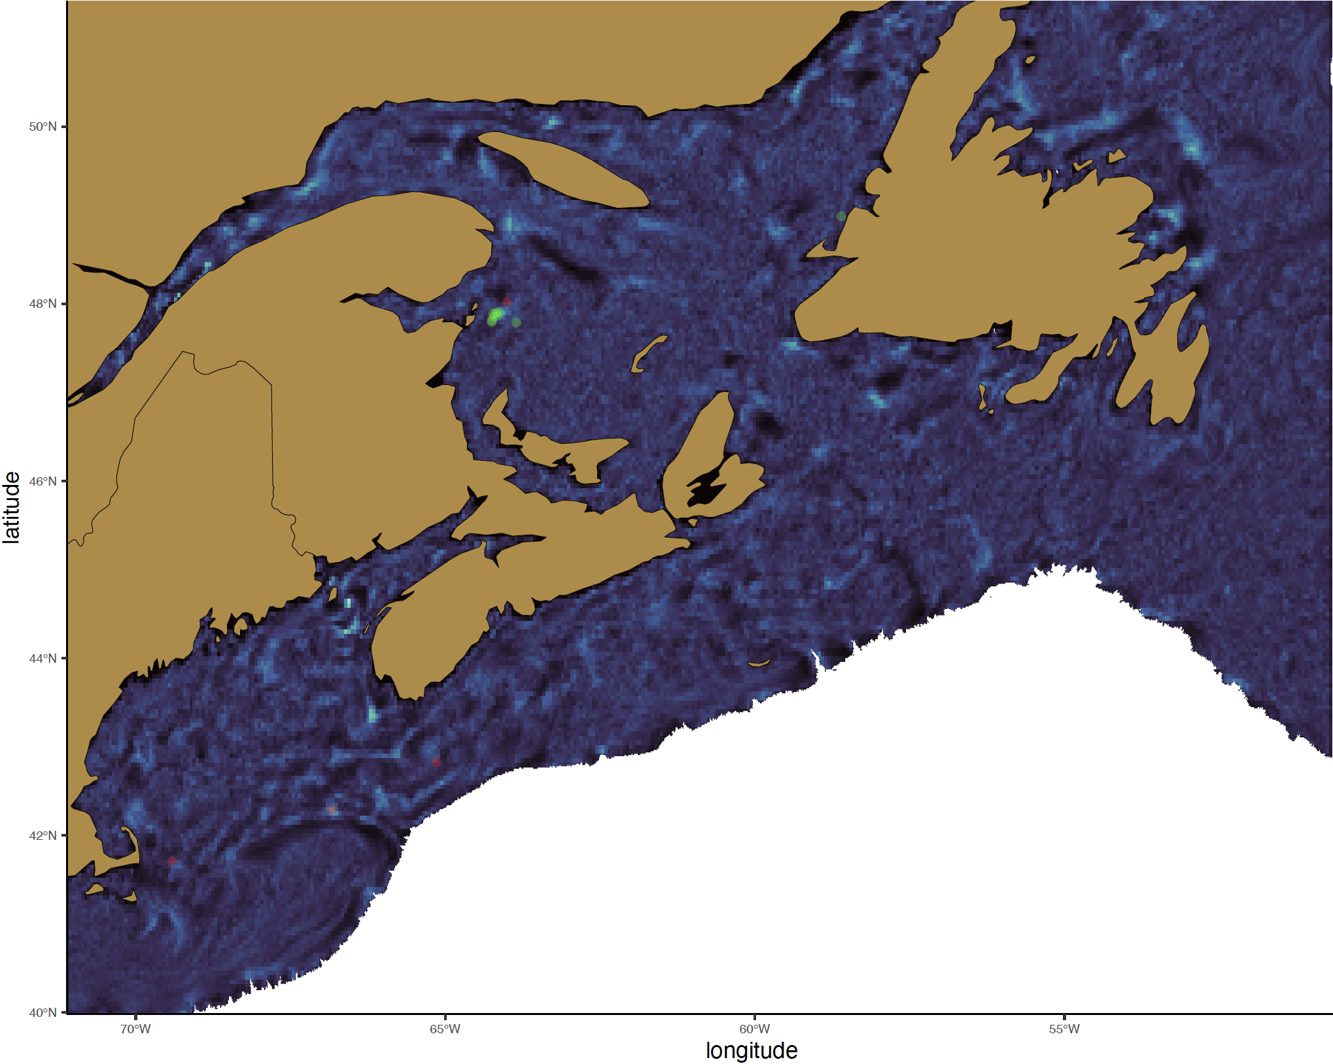
2018
May - 24
Late C. hyperboreus

Slide 4
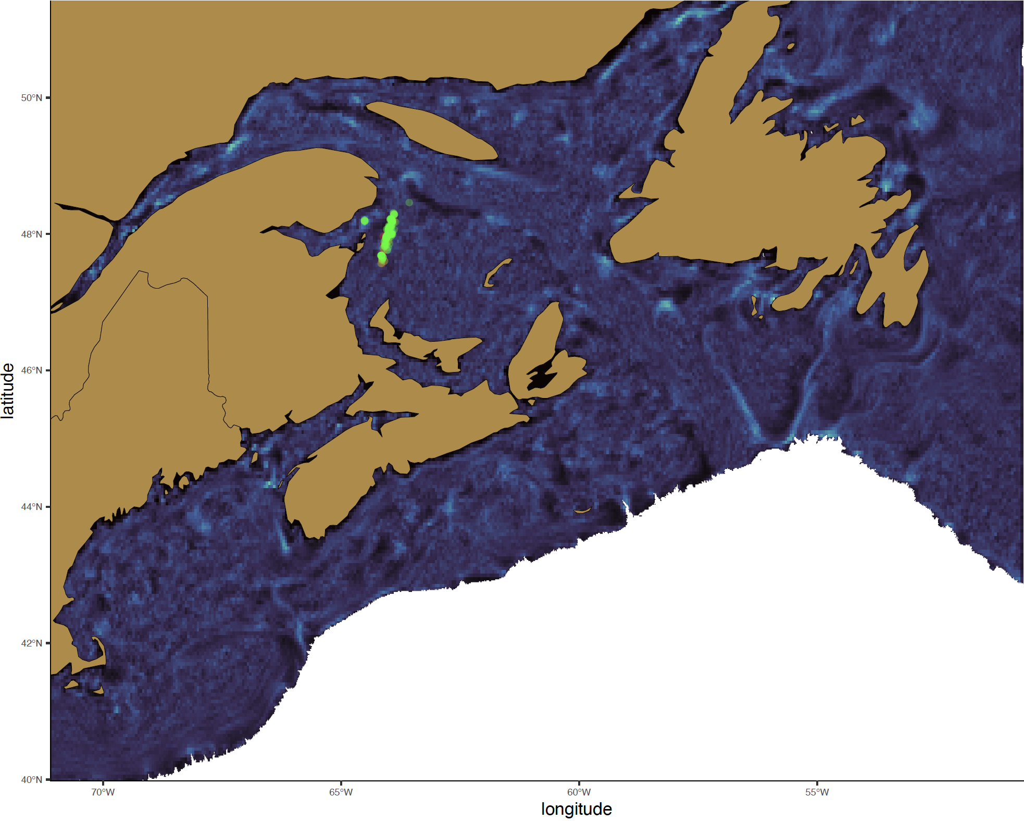
2018
June - 01
Late C. hyperboreus

Slide 5
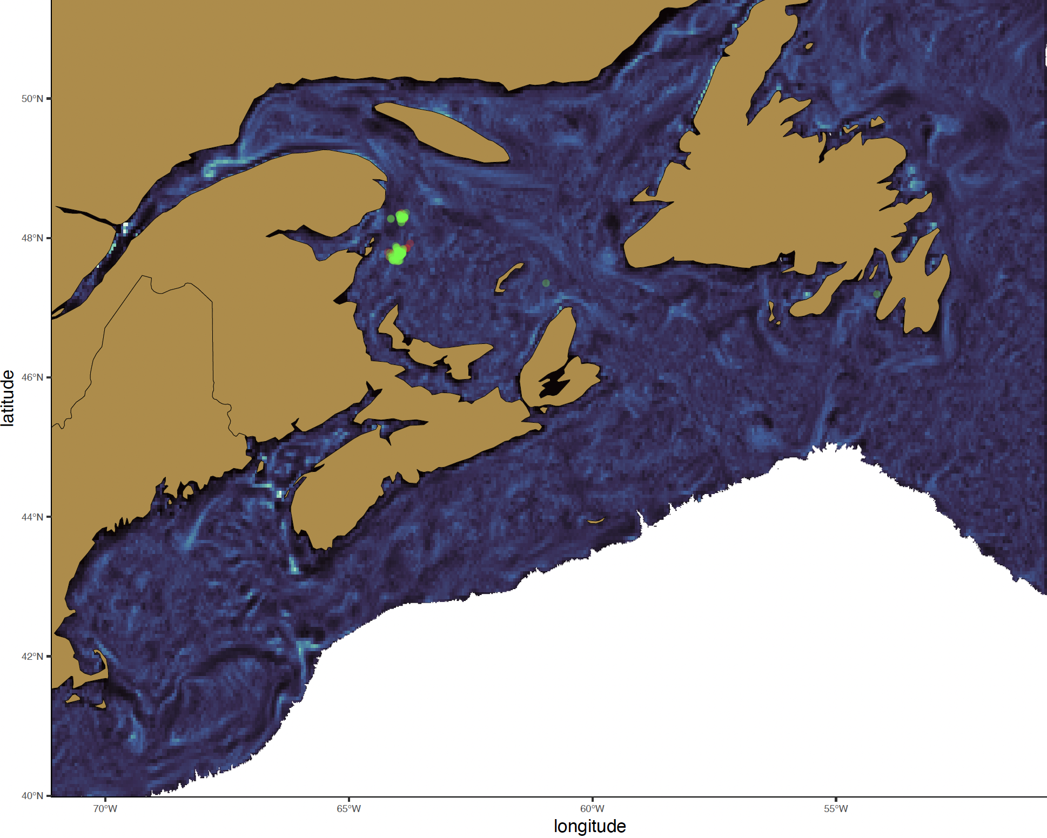
2018
June - 09
Late C. hyperboreus

Slide 6
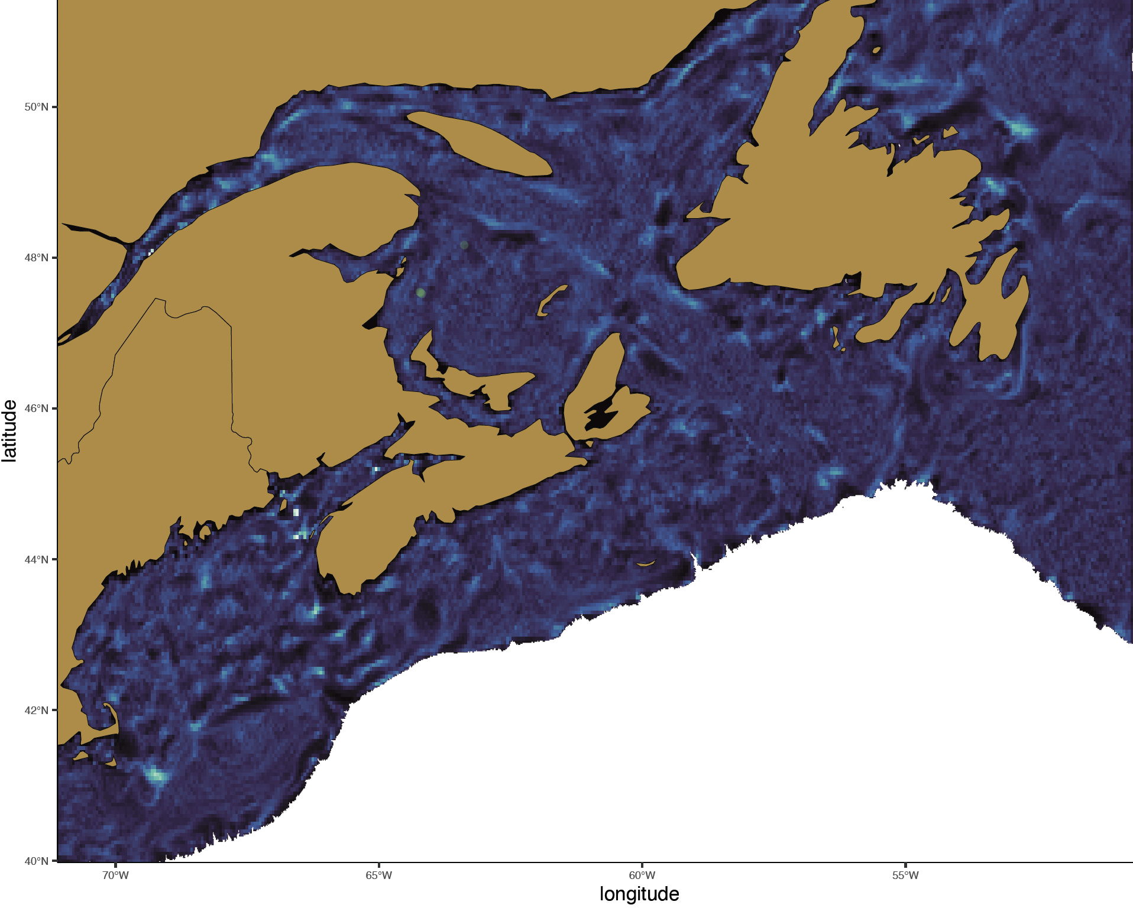
2018
June - 17
Late C. hyperboreus

Slide 7

2018
June - 25
Late C. hyperboreus

Slide 8

2018
July - 03
Late C. hyperboreus

Slide 9
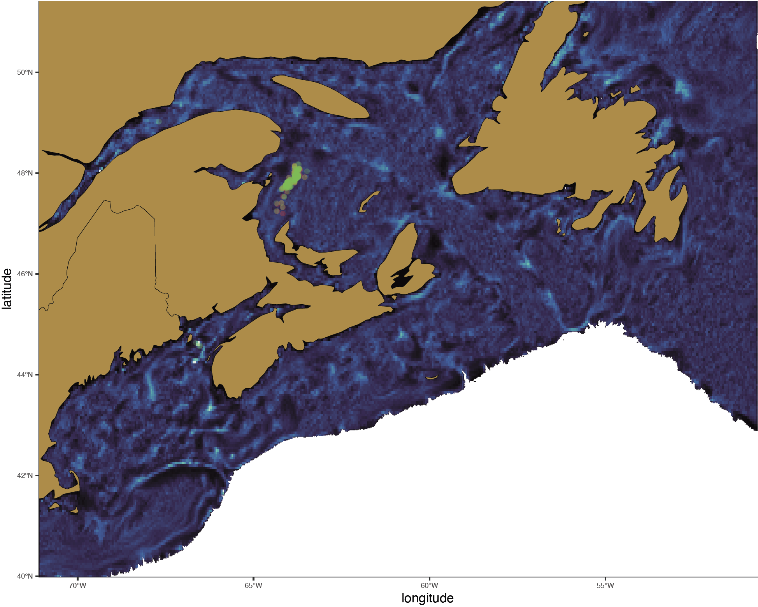
2018
July - 11
Late C. hyperboreus

Slide 10
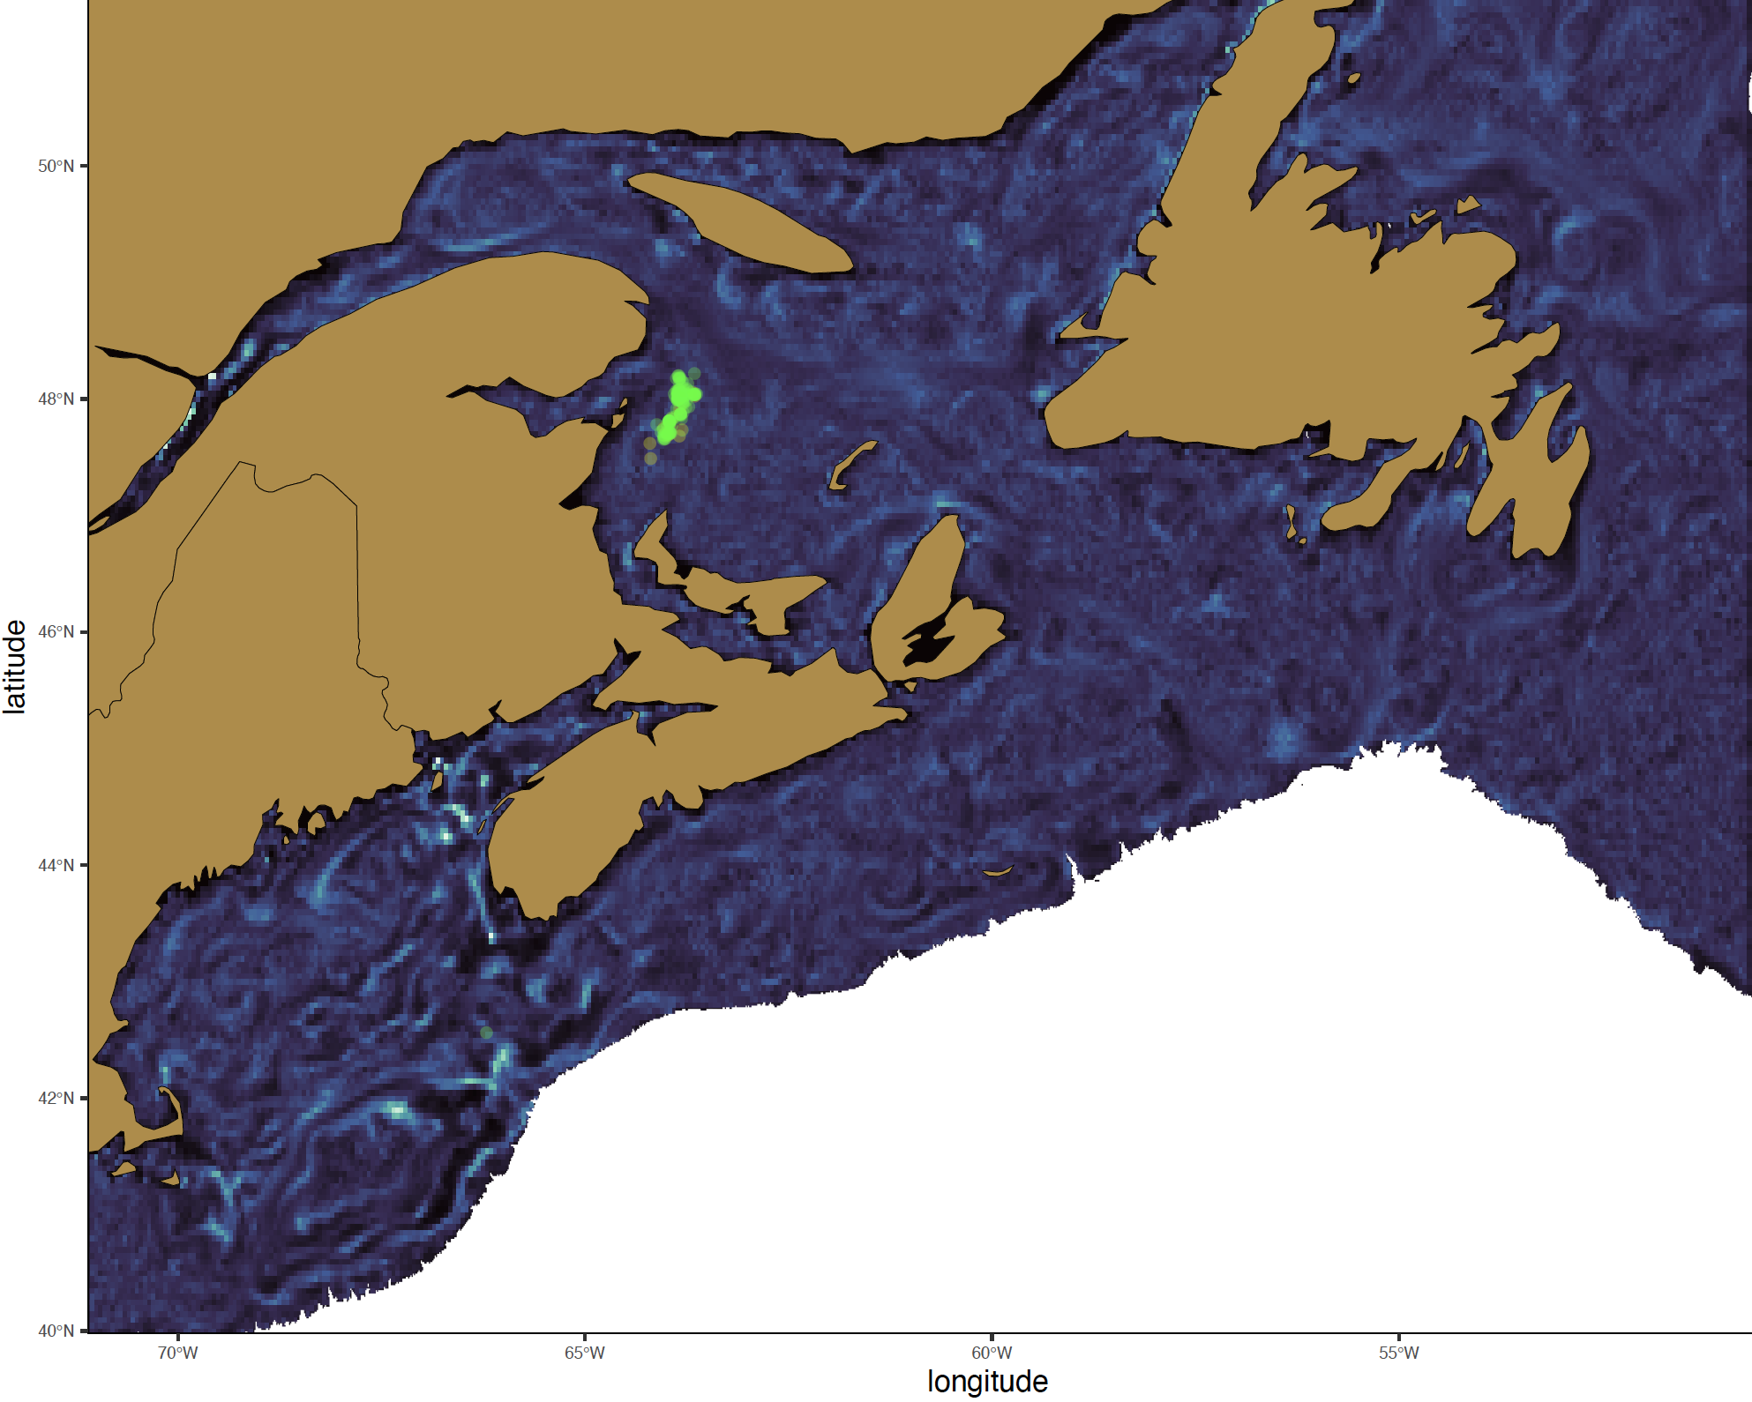
2018
July - 19
Late C. hyperboreus

Slide 11

2018
July - 27
Late C. hyperboreus

Slide 12
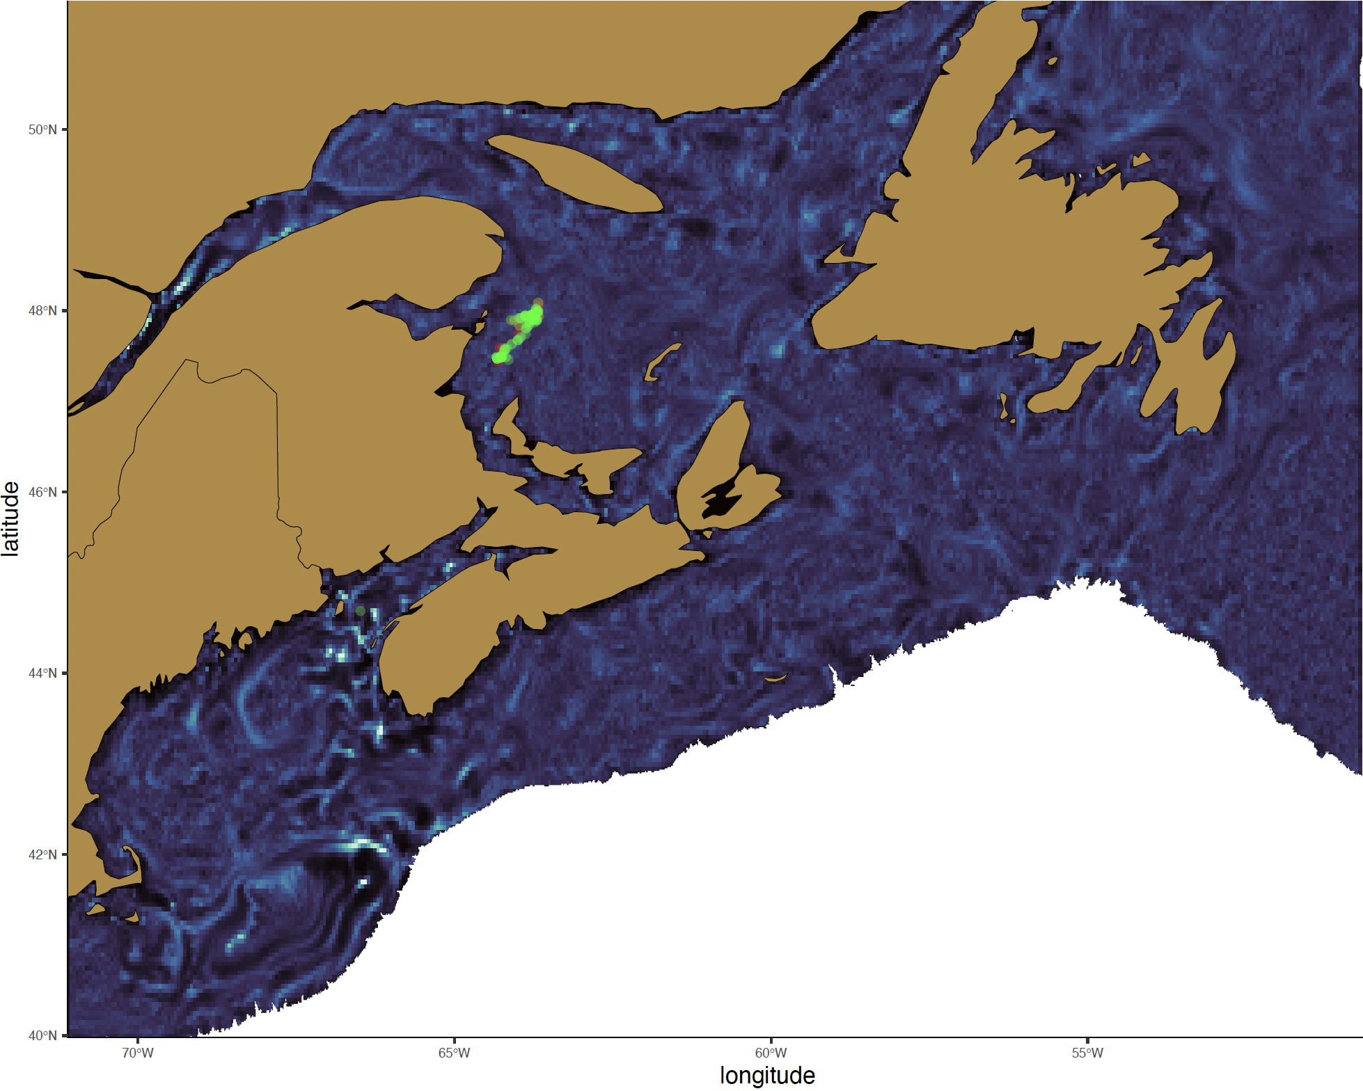
2018
August - 04
Late C. hyperboreus

Slide 13
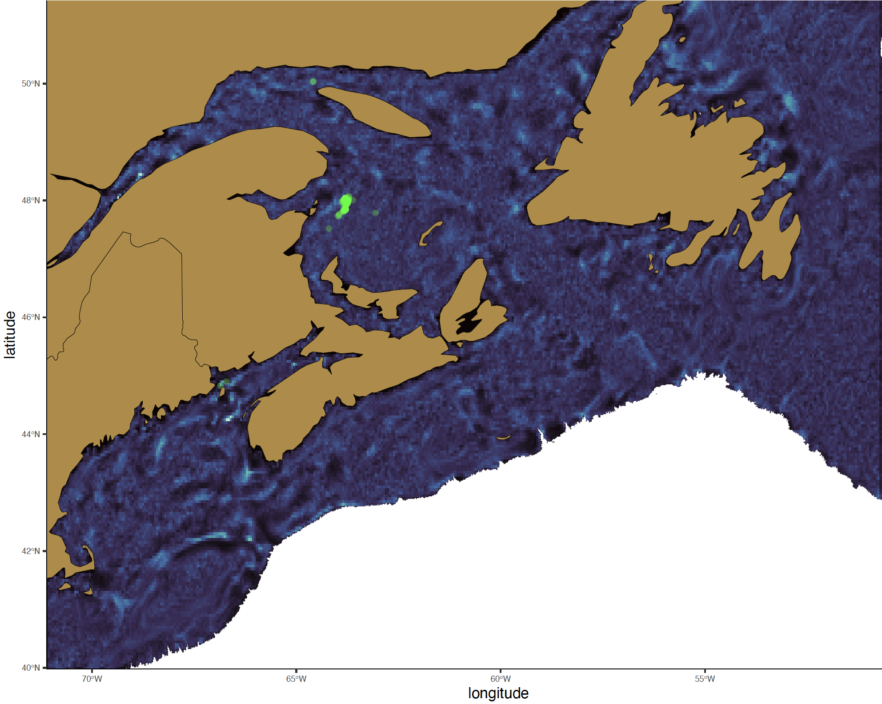
2018
August - 12
Late C. hyperboreus

Slide 14
2018
August - 20
Late C. hyperboreus

Slide 15

2018
August - 28
Late C. hyperboreus

Slide 16
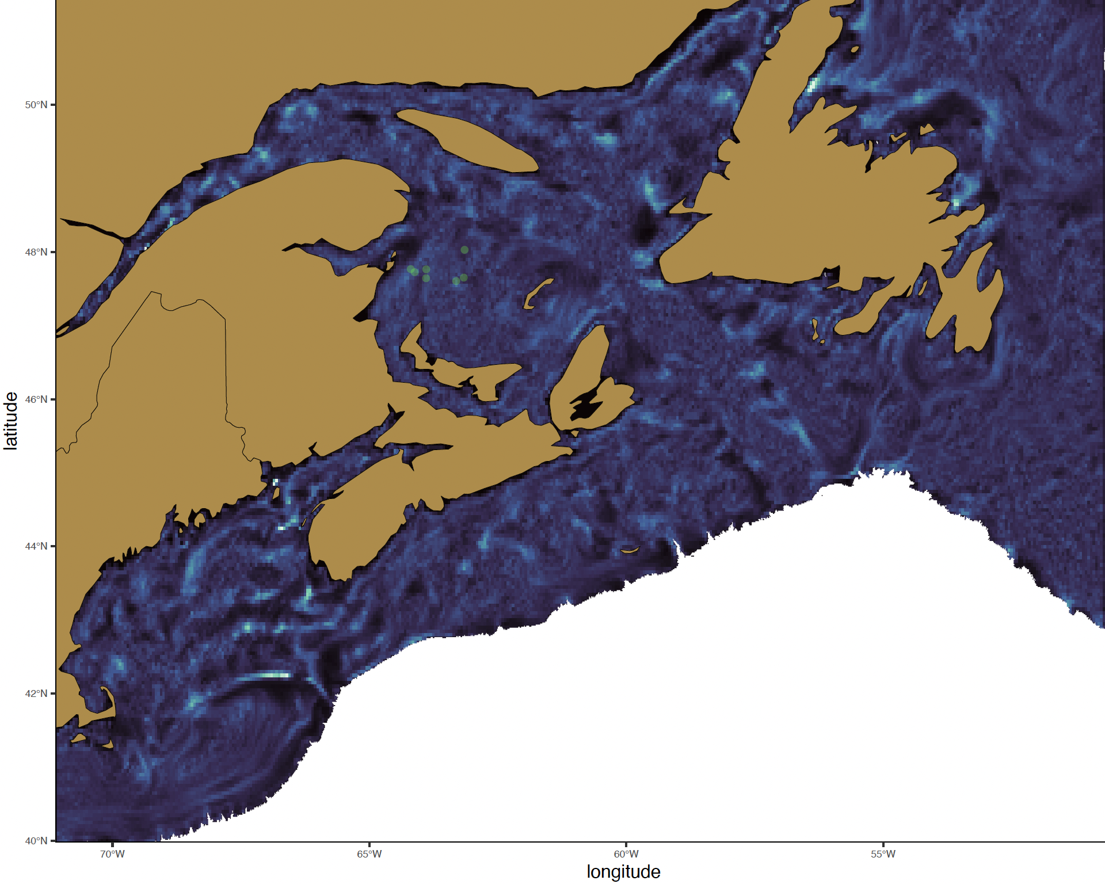
2018
September - 05
Late C. hyperboreus

Slide 17

2018
September - 13
Late C. hyperboreus

Slide 18

2018
September - 21
Late C. hyperboreus

Slide 19

2018
September - 29
Late C. hyperboreus

